Slide 1

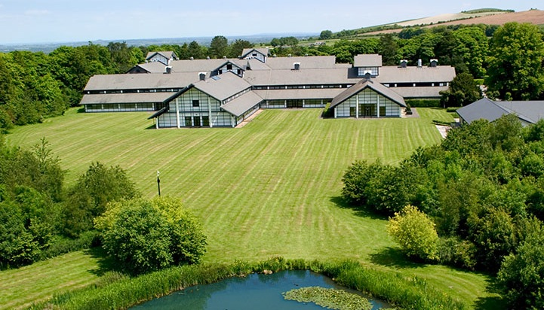
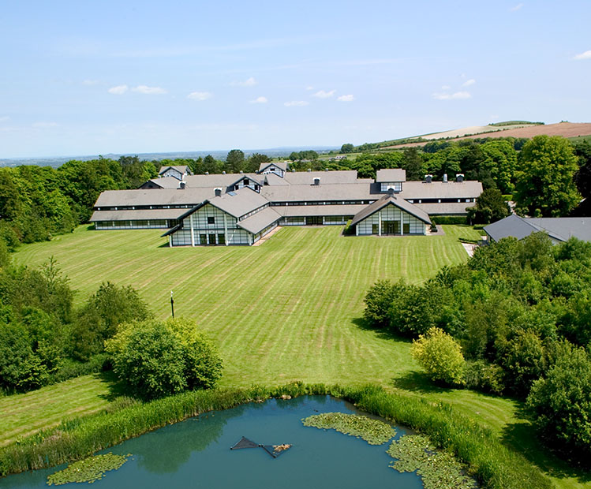
Liddington
Wiltshire

Slide 2
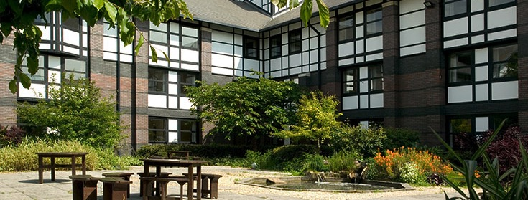

LEARNING OUTSIDE
Liddington - Wiltshire
New extended accommodation, dining and activity facilities
25 fantastic adventure activities to choose from
150 acres of beautiful grounds
Explore the 360 Virtual Tour www.pgl.co.uk/liddington360 to see inside the centre and view activity information and videos

Slide 3
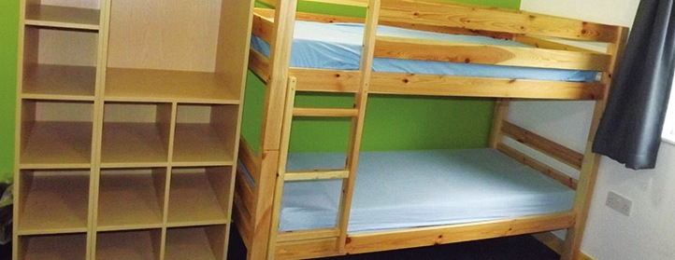
Accommodation
Main Building – en suite rooms sleep 3-6
King Edward’s House – en suite rooms sleep 2-6
The Ridgeway – en suite rooms sleep 4
Accommodation for Liddington can be viewed in the 360 virtual tour: www.pgl.co.uk/liddington360
Notes:
The centre can accommodate 1000 guests at a time with accommodation in the main building, Kind Edward’s House or the Ridgeway
Teachers are usually accommodated in twin rooms with en suite and hot drink facilities
All rooms are lockable (party leader given master key)
All exterior doors and gates are locked at night but can be opened from the inside in an emergency without the need for unlocking
A PGL staff member is available on duty throughout the night (contactable by phone)
The extensive facilities (other than activity bases) are available to your group during free time

Slide 4
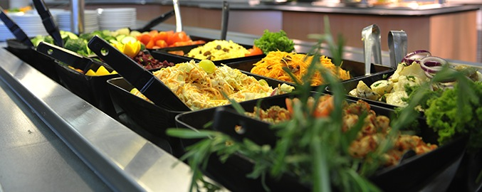
Catering and dietary needs
3 nutritious, balanced meals per day
Self-service salad bar
Vegetarian option
Special diets catered for by prior arrangement
Sample menus available online: www.pgl.co.uk
Notes:
We continually invest in healthy menus with freshly cooked ingredients obtained from fully traceable audited suppliers
Processed food is avoided and meals meet Local Authority guidelines
There will be hot and cold options available at every meal
At lunch and dinner the buffet includes a salad bar and mixed fruit basket plus hot and cold drinks
Our caterers can deal with most dietary requirements but please ensure the party leader is aware of any dietary requirements well in advance
More food is always available if required

Slide 5
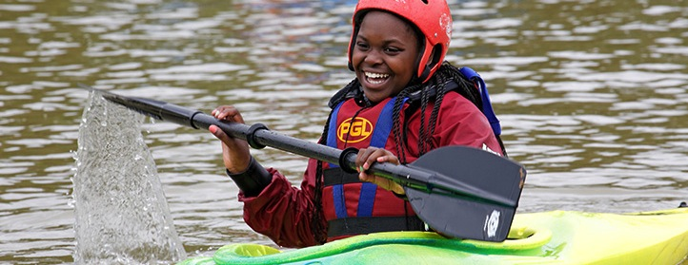
Adventure activities
Abseiling
Aeroball
Archery
Canoeing
Challenge Course
Climbing
Crate Challenge
Fencing
First Aid
Giant Swing
Jacob’s Ladder
Mountain Biking
Nature Trail
Orienteering
Problem Solving
Quad Biking
Raft Building
Sensory Trail
Sports and Team Games
Survivor
Trapeze
Treetop Study Trail
Tunnel Trail
Vertical Challenge
Zip Wire
Notes:
The activities shown offer individual as well as team challenges.
Activities are designed to encourage new skills and develop existing ones.
Specific activities can be requested (though not guaranteed) and the programme is discussed on arrival at the centre.

Slide 6
So what does PGL give your child other than a great time?
Independence:
Looking after themselves and their belongings
Being on time – thinking about how long they need to get ready without being reminded or guided.
Organised – making sure that they have what they need for the time they are away from their room.
Choosing food for themselves – making the right decisions.

Slide 7
Resilience and perseverance:
Trying something new for the very first time.
Having a good go at activities, even when they feel completely out of their comfort zone.
They will find confidence in themselves and in others.
Working together, encouraging and supporting each other will really help.

Slide 8
PGL 2027
Monday 14th – Friday 18th June 2027
The new deposit of £60 must be paid by the 11th June to secure your child's place – this is non-refundable
This will go live on ‘School Money’ before half term.
The full price cannot be confirmed until we know how many children wish to attend, however it will be between £540 and £560
This can be paid in four instalments
The price includes: accommodation /bedding/ food/ coach and activities

